Slide 1

Disjoint Set Union (DSU)

Slide 2
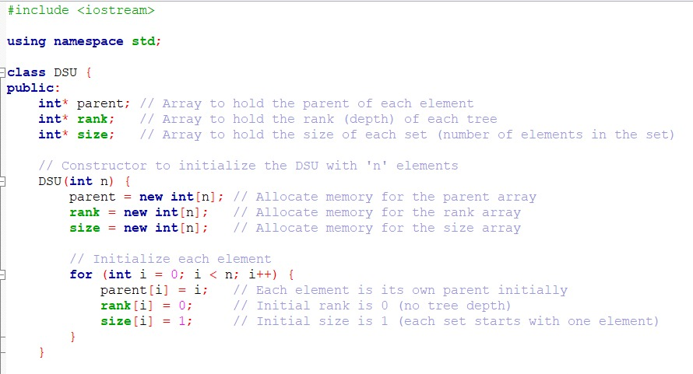
DSU Class
Firstly, we create three pointers (parent , rank , size).
First pointer to hold the parent of each element in an array.
Second pointer to hold the depth of each tree in an array.
Third pointer to hold the number of elements in the set in an array.
Secondly, allocating the memory for the parent, rank, and size arrays.
Finally, we initialize each element.

Slide 3
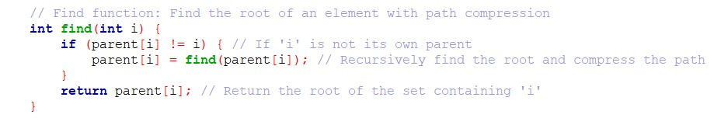
Find Function
This function is a parameterized function that takes an input number from the user to search for the parent of the number if it exists.
The (if statement) checks if the input is not it’s own parent.
We recursively use the find function to find the root and compress the path.
If the condition is false, the function returns the root of the set containing the (i).

Slide 4
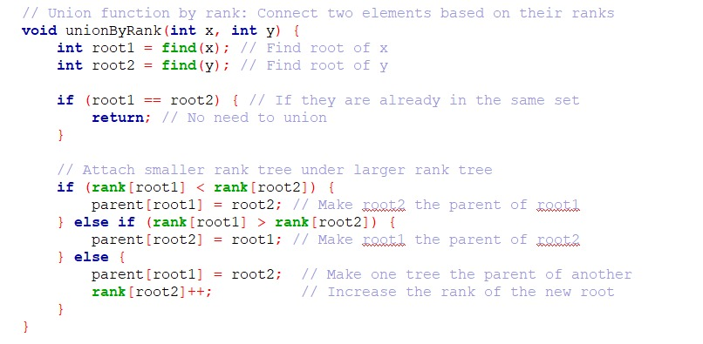
Union By Rank Function
This function takes two parameters & connects two trees based on their ranks.
First, we find the parent of the two parameters and store them in two variables (root1 , root2).
Second, we check if they have the same parent, there is no need to union.
Third, we check if rank of root2>rank of root1, then root2 will be the parent of root1 and vice versa.
Finally, if they are equal make one tree the parent of the other and increase the rank of it.

Slide 5
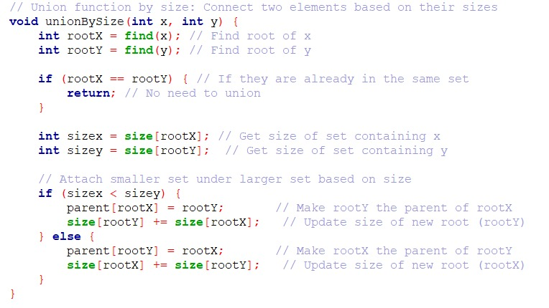
Union By Size Function
This function takes 2 parameters & connects two trees based on their size.
First, we find the parent of the two parameters and store them in two variables (rootX , rootY).
Second, we check if they have the same parent, there is no need to union.
Third, we store the sizes of each tree in two variables (sizex , sizey).
Finally, we check if sizex< sizey , then rootY will be the parent of rootX and update the size of the new root and vice versa.

Slide 6

Is connect Function
This function checks if the two sets are connected or not connected by checking if the two parameters have the same parent or not.

Slide 7
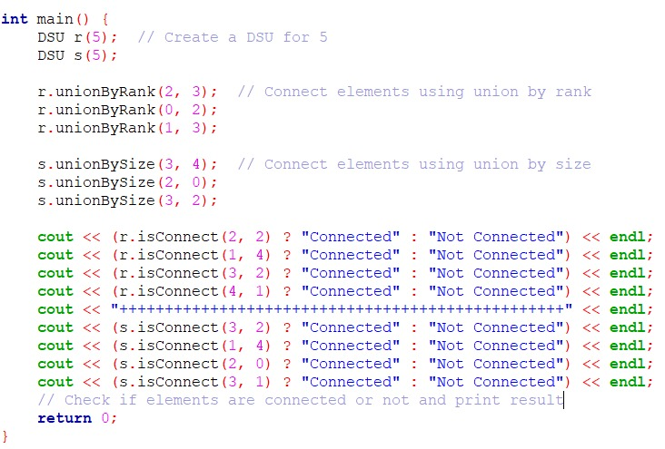
Main Function
We created two objects (r , s)of the DSU class each for five elements.
This code created five parents in r and s objects which we tested later on.
We tested both union by rank function and union by size function three tests.
Finally, we checked in the ‘cout’ process if the elements are connected or not by using if(?) and else(:) statements.
Now it’s time to discuss and test together.

Slide 8
Citations
YouTube Video : https://www.youtube.com/watch?v=HQ5ANfzSDn0&t=237s
Geeks for geeks : https://www.geeksforgeeks.org/disjoint-set-data-structures/

Slide 9
El Hanooty Team
Yousuf Idrees 23-101077
Yassin Sameh 23-101192
Omar Elsayed 23-101091

